Slide 1
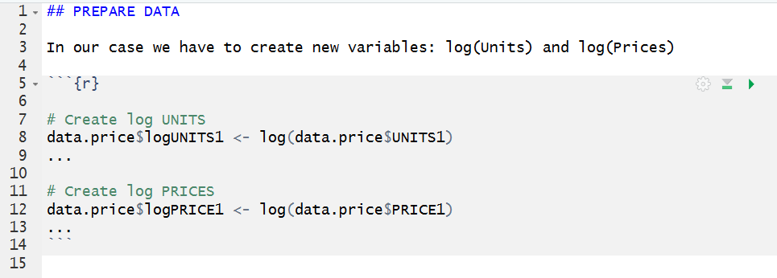
We often have to create some new variables from our data. In my example here the data is called “data.price”
log (take the natural logarithm) of the data vector
Make a new data vector
data.price$UNITS1 tell R to take the data vector UNITS1 from the data set data.price.
Name of the new vector is “logUNITS1” (your choice here), having “data.prices$” in front of the name adds the new vector to the existing data set called “data.price”

